Slide 1
Security Information and Event Management Mentor: Mr. Jatin Sethi
Bineek Raja, Vikash Anand, Vandana Sharma, Mohit Pandey
B-Tech Computer Science Engineering with Specialization in BFSI – 7th Semester

Slide 2
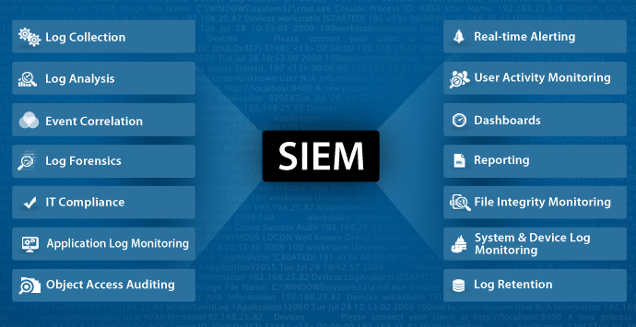
Abstract
Security information and event management (SIEM) technology supports threat detection and security incident response through the real-time collection and historical analysis of security events from a wide variety of event and contextual data sources. The core capabilities of SIEM technology are a broad scope of event collection and the ability to correlate and analyze events across disparate sources. There is a need to provide cost effective open source application that can provide threat detection through real time analysis of security alerts generated by network components which would be helpful for small organisations.
This application will provide real-time monitoring, correlation of events, notifications, console views and provides long-term storage as well as analysis, manipulation based on reporting of log data and security records.

Slide 3
Introduction
Security information and event management (SIEM) software products and services combine security information management (SIM) and security event management (SEM). They provide real-time analysis of security alerts generated by network hardware and applications.
The segment of security management that deals with real-time monitoring, correlation of events, notifications and console views is known as security event management (SEM). The second area provides long-term storage as well as analysis, manipulation and reporting of log data and security records of the type collated by SEM software, and is known as security information management (SIM).
The term security information event management (SIEM), coined by Mark Nicolett and Amrit Williams of Gartner in 2005,
The product capabilities of gathering, analyzing and presenting information from network and security devices
Identity and access-management applications
Vulnerability management and policy-compliance tools
Operating-system, database and application logs
External threat data
A key focus is to monitor and help manage user and service privileges, directory services and other system-configuration changes; as well as providing log auditing and review and incident response.

Slide 4
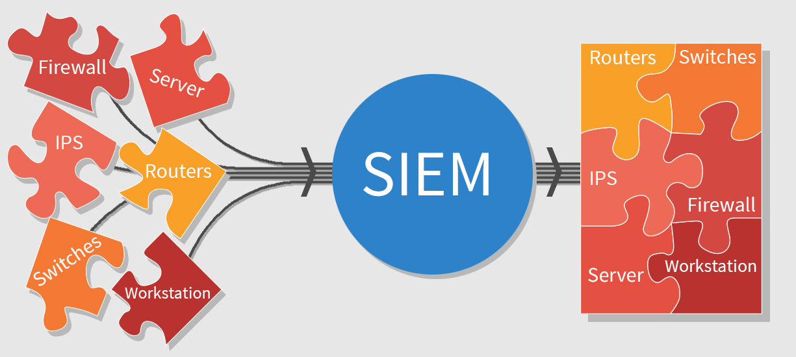
Problem Statement
There is a need to provide cost effective open source application that can provide threat detection through real time analysis of security alerts generated by network components which would be helpful for small organisations.

Slide 5
Objective
To develop an application which can provide real-time monitoring, correlation of events, notifications, console views and provides long-term storage as well as analysis, manipulation and reporting of log data and security records.

Slide 6
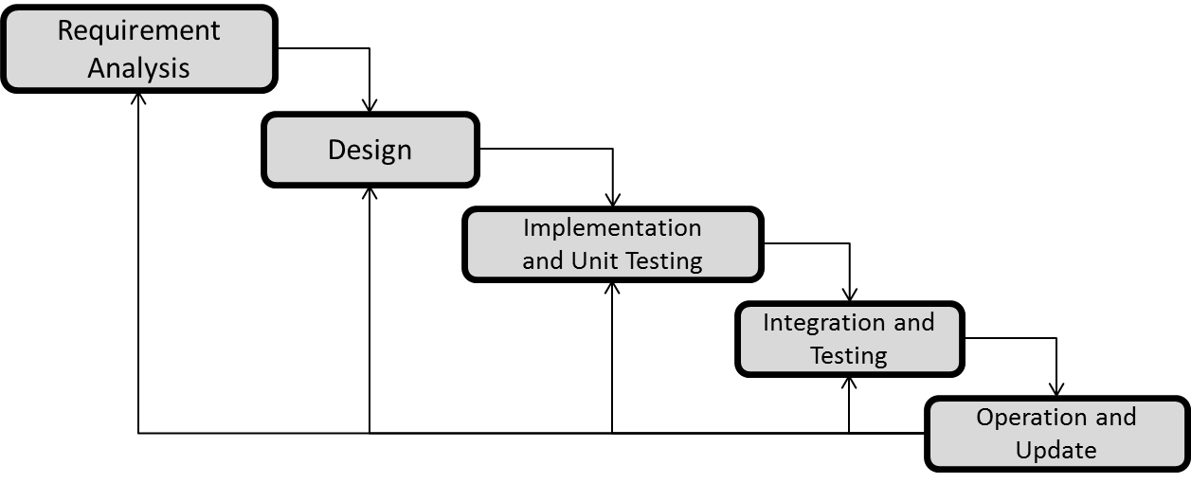
Methodology
We are using ITERATIVE WATERFALL MODEL due to large data size and complexity of our project.

Slide 7
Requirement Analysis:
Logs are required for analyzing the successful and failed logs at firewall, apache server and application. For this we have collected different types of firewall logs, apache server logs and application logs.
Firewell Logs:
2006-09-19 03:26:26 DROP UDP 172.20.73.241 239.255.255.250 2250 1900 315 - - - - - - - RECEIVE
2006-09-19 03:26:26 DROP UDP 172.20.73.241 239.255.255.250 2250 1900 305 - - - - - - - RECEIVE
2006-09-19 03:27:05 CLOSE UDP 192.168.72.12 10.20.72.186 3682 88 - - - - - - - - -
2006-09-19 03:27:05 CLOSE UDP 192.168.72.12 10.20.72.186 3683 88 - - - - - - - - -
2006-09-19 03:27:53 CLOSE TCP 192.168.72.12 10.20.72.186 3680 445 - - - - - - - - -
2006-09-19 03:29:24 DROP UDP 172.20.73.241 239.255.255.250 2250 1900 250 - - - - - - - RECEIVE
2006-09-19 03:29:24 DROP UDP 172.20.73.241 239.255.255.250 2250 1900 315 - - - - - - - RECEIVE
2006-09-19 03:29:24 DROP UDP 172.20.73.241 239.255.255.250 2250 1900 263 - - - - - - - RECEIVE
2006-09-19 03:29:24 DROP UDP 172.20.73.241 239.255.255.250 2250 1900 315 - - - - - - - RECEIVE
2006-09-19 03:29:24 DROP UDP 172.20.73.241 239.255.255.250 2250 1900 305 - - - - - - - RECEIVE
2006-09-19 03:31:15 DROP UDP 192.168.183.114 239.255.255.250 65173 1900 310 - - - - - - - RECEIVE
Apache Logs:
1 192.168.72.12 9/19/2006 3:37:58 GET HTTP 200 3683
2 192.168.99.165 9/19/2006 3:45:36 GET HTTP 200 1900
3 192.168.183.114 9/19/2006 3:45:43 GET HTTP 200 65166
4 222.225.225.1 9/20/2006 3:29:24 GET HTTP 200 2250
5 193.168.82.10 9/20/2006 3:38:20 GET HTTP 452 1025
6 226.222.222.3 9/20/2006 3:35:57 GET HTTP 200 65170
7 128.2.2.2 9/20/2006 3:32:18 GET HTTP 582 1900

Slide 8
Application Logs:
1 192.168.72.12 9/19/2006 3:37:58 GET HTTP 200 3683
2 192.168.99.165 9/19/2006 3:45:36 GET HTTP 200 1900
3 192.168.183.114 9/19/2006 3:45:43 GET HTTP 200 65166
4 222.225.225.1 9/20/2006 3:29:24 GET HTTP 200 2250
5 226.222.222.3 9/20/2006 3:35:57 GET HTTP 985 65170

Slide 9
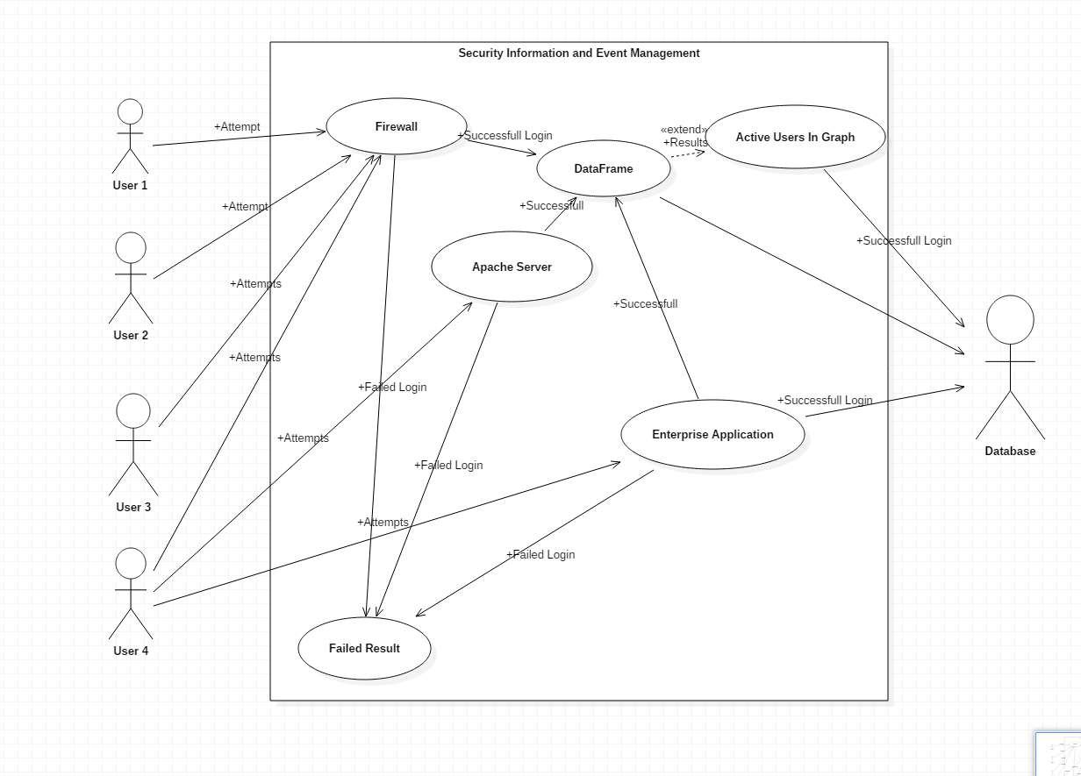
Design: (Use Case Diagram)

Slide 10
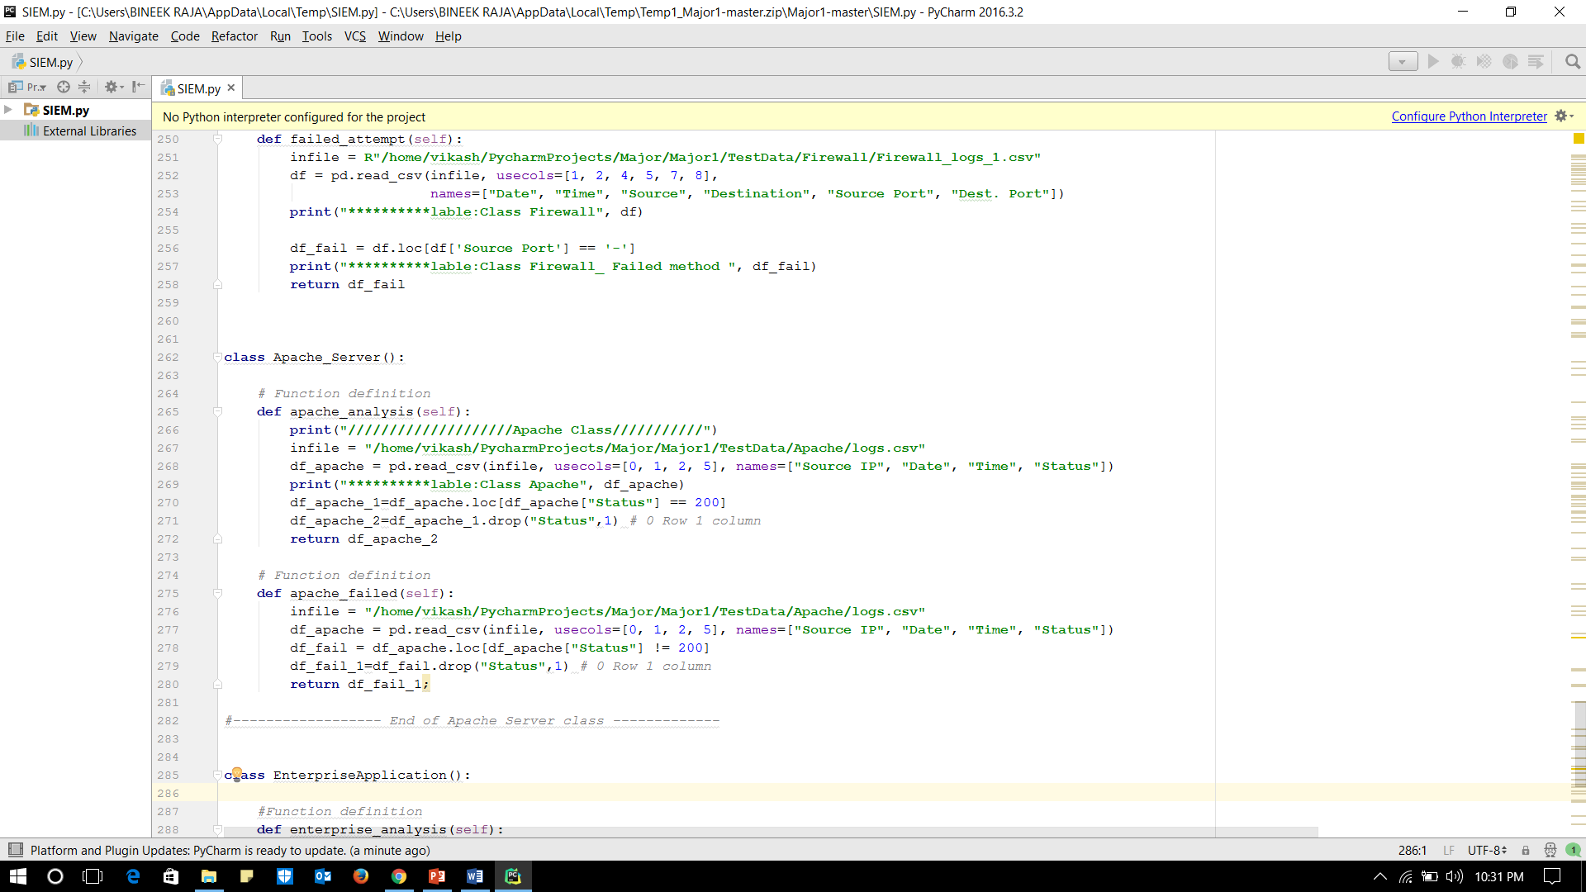
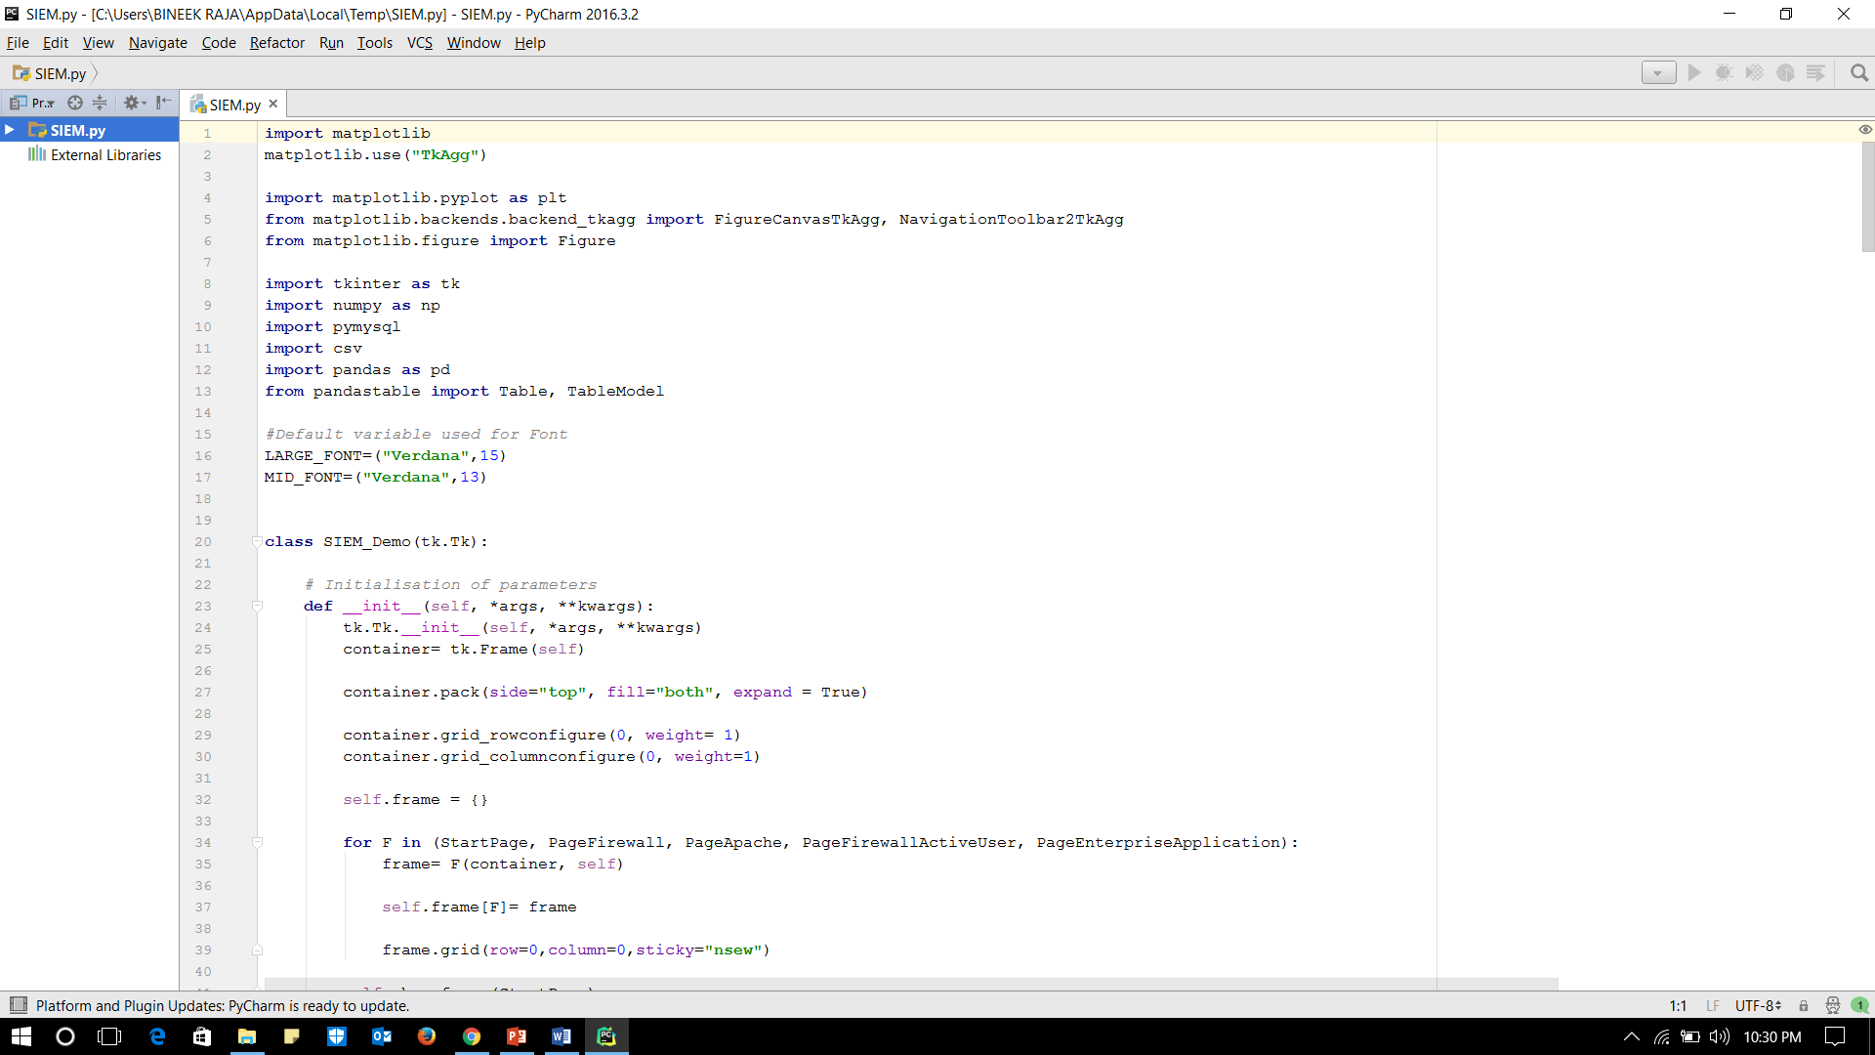
Implementation ( Code Snapshots)

Slide 11
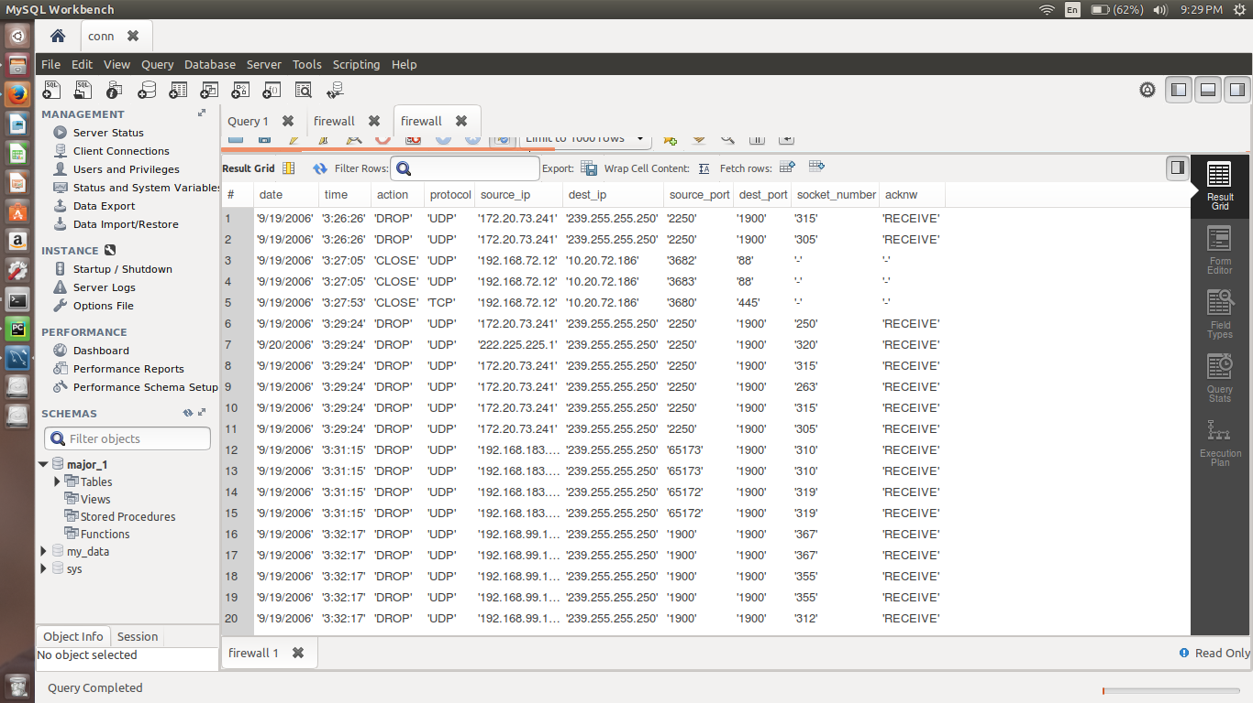
Database:

Slide 12
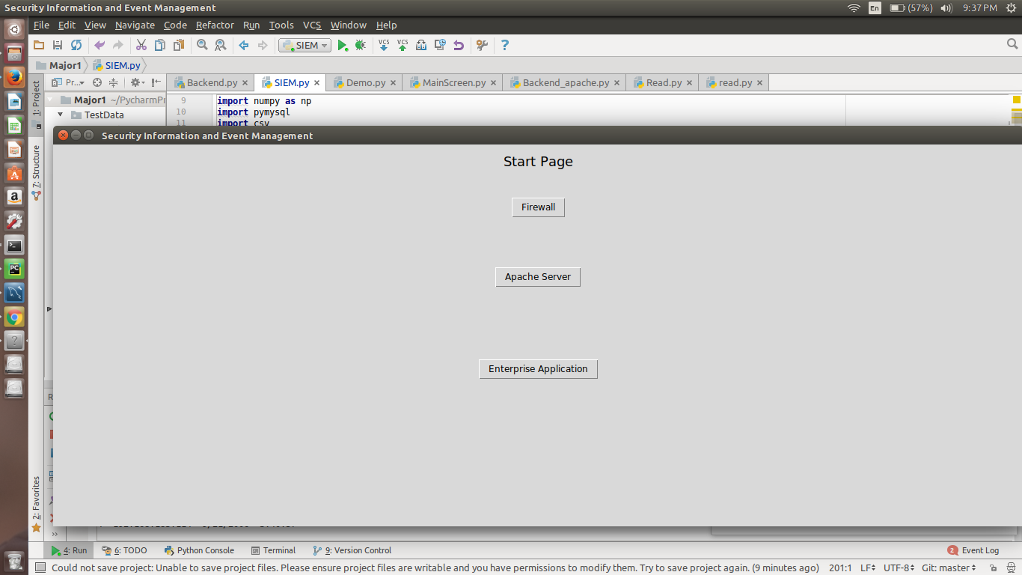
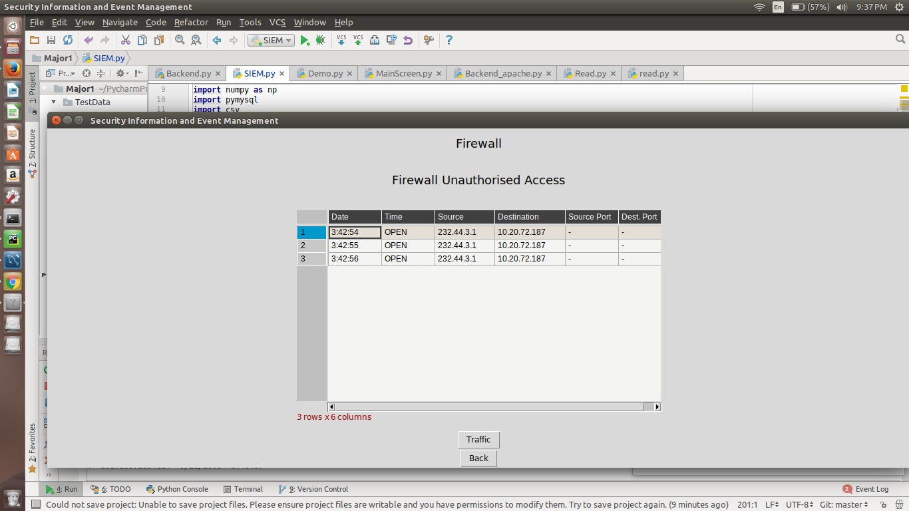
Snapshots

Slide 13
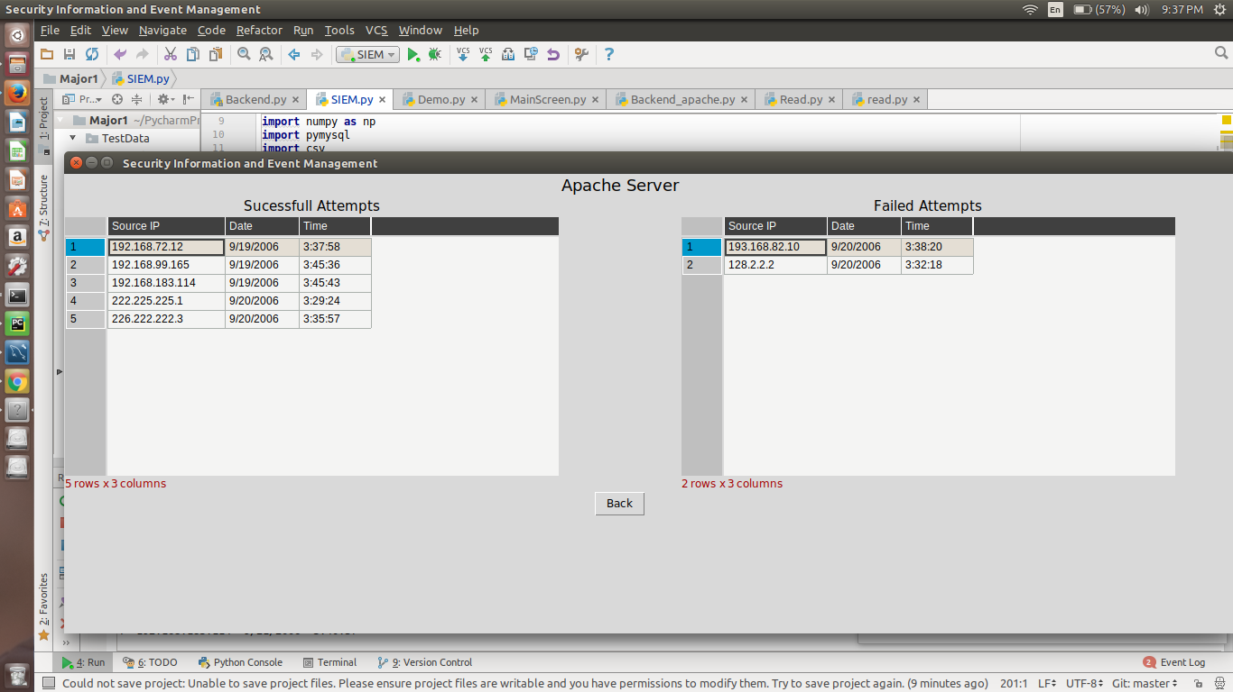
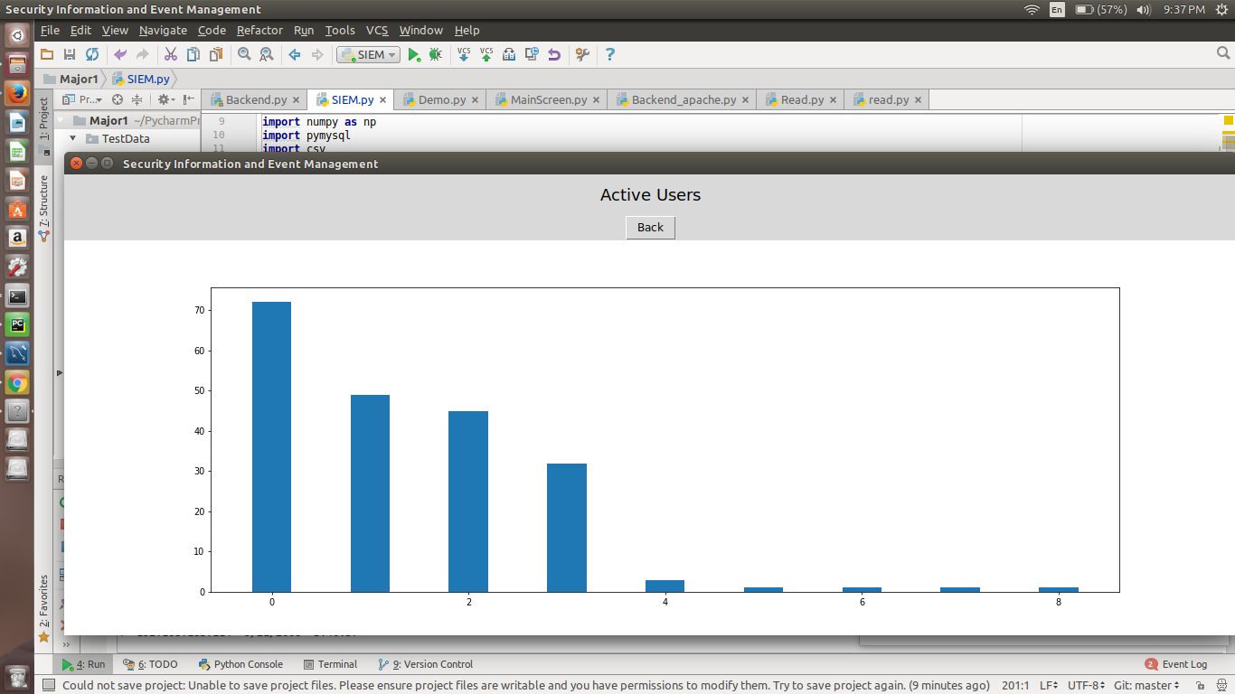
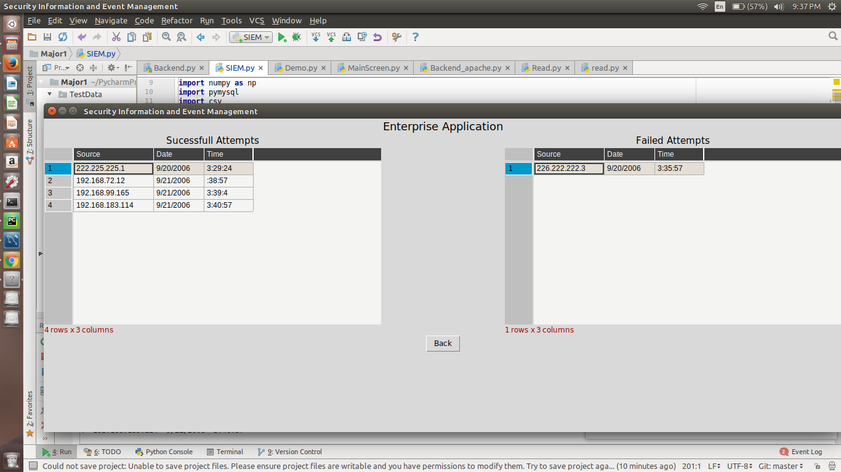
Snapshots

Slide 14
System Requirements
SOFTWARE REQUIREMENTS
Language – Python 3
Compiler – Python
Operating System – Windows
IDE – PyCharm
HARDWARE REQUIREMENTS
2 GHz dual core processor or better
2 GB system memory
25 GB of free hard drive space

Slide 15
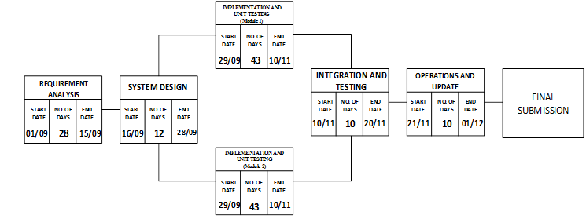
Pert Chart

Slide 16
Future Enhancements
There is always a room for improvements in any software package, however good or efficient it may be done. But the most important thing is flexible to accept further modification. We can always increase analysis of logs by increasing the data set provides as it will lead to more accurate results. Apart from that we restrict our self only on the logs generated by firewall, apache server and enterprise application in this project but these can also be expanded as per the need.

Slide 17
References
“Successful SIEM and Log Management Strategies for Audit and Compliance” Swift, David, 4 November 2010
“Magic Quadrant for Security Information and Event Management” Bussa, Toby & Kavanagh, Kelly, 10 August 2016

Slide 18
Thankyou

